Slide 1
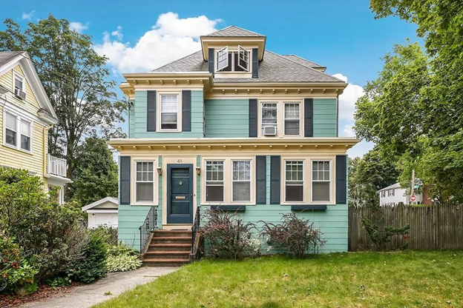
House Price Prediction in Boston
DATA 606 Capstone Project
PROF: Chaojie Wang
By:
Manasvi Pentareddy

Slide 2

CONTENTS OF THE PRESENTATION
INTRODUCTION
PREPROCESING
EDA TECHNIQUES
MACHINE LEARNING MODELS
WEB APPLICATION

Slide 3
INTRODUCTION
In real estate transactions, housing prices are crucial and function as an indicator of the status of the economy. While typical features like bedrooms or fences may be the first things that buyers consider when imagining their ideal house, this dataset shows that many other elements also play a significant role in price negotiations. Property prices may be greatly impacted by variables like local amenities, accessibility to transit, and structural features, highlighting the complex dynamics of real estate that go beyond common assumptions.

Slide 4
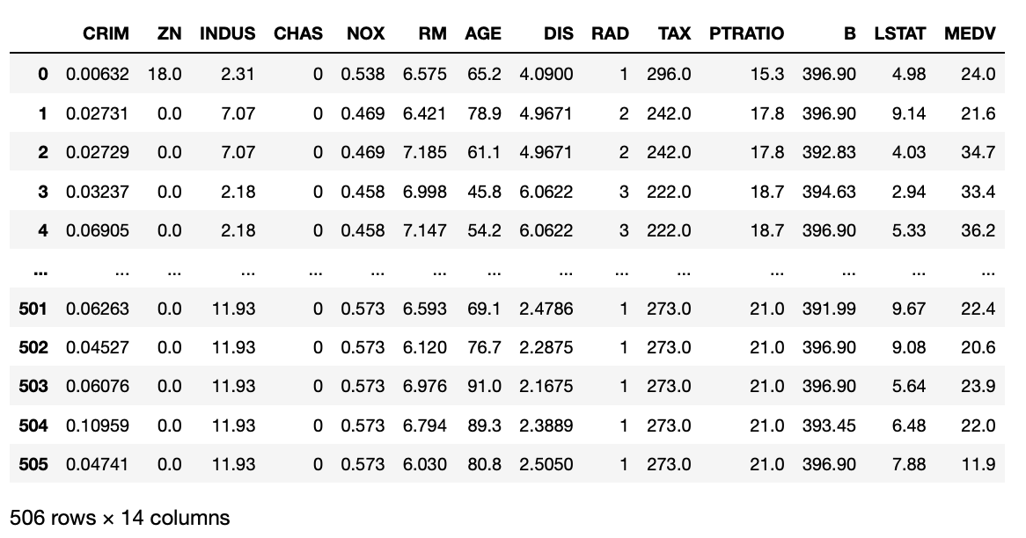
ABOUT THE DATA

Slide 5
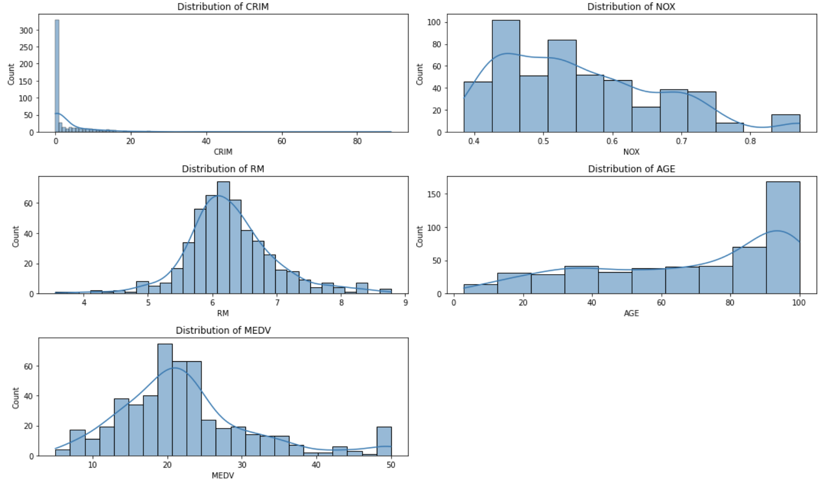
Univariate Analysis Histogram for 'CRIM', 'NOX', 'RM', 'AGE’, ‘MEDV’.

Slide 6
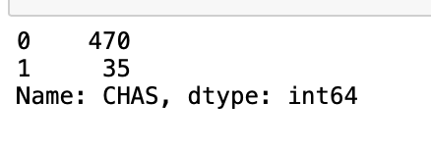
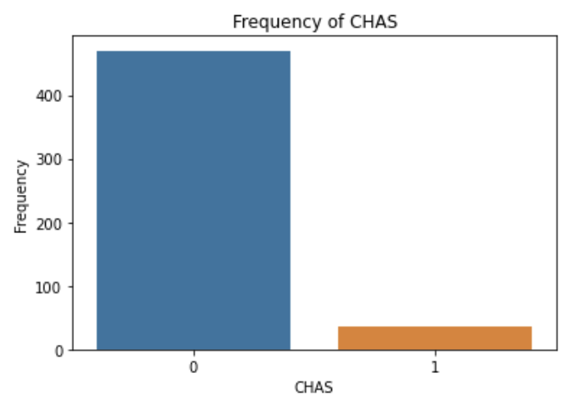
Showcasing CHAS value counts
Bar Plot plotting the value counts of 'CHAS’
Numeric summary

Slide 7
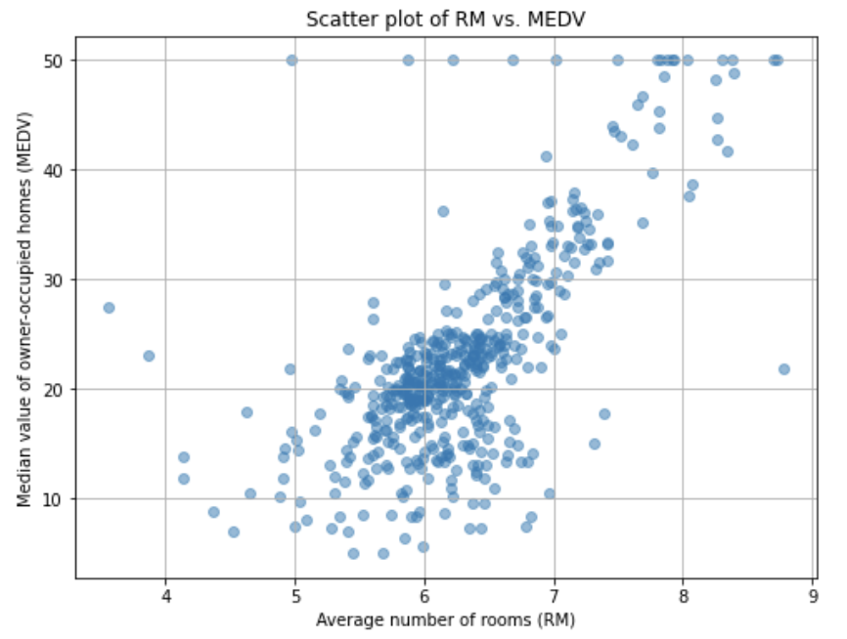
Bivariate Analysis Scatter plot of 'RM' and 'Price’

Slide 8
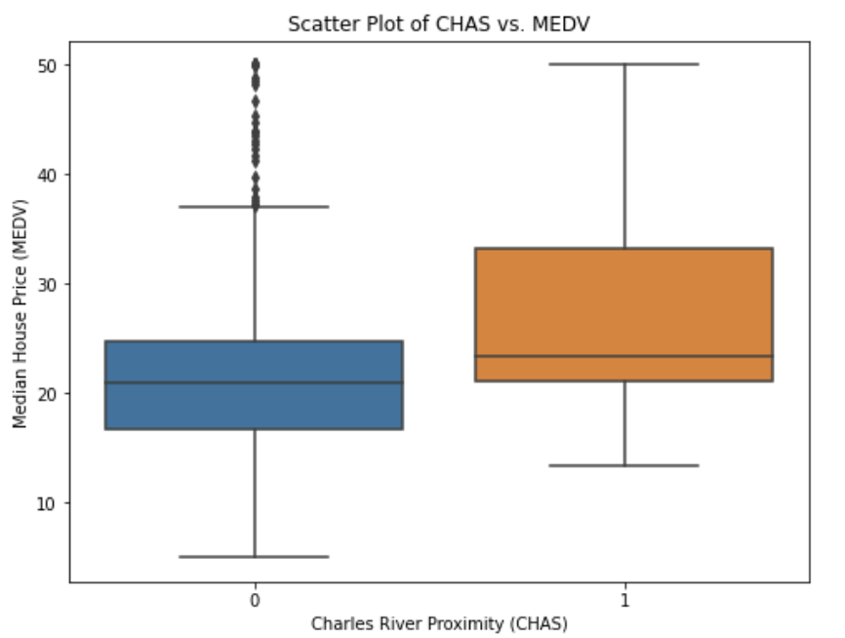
Box plot for 'CHAS and 'MEDV'.

Slide 9
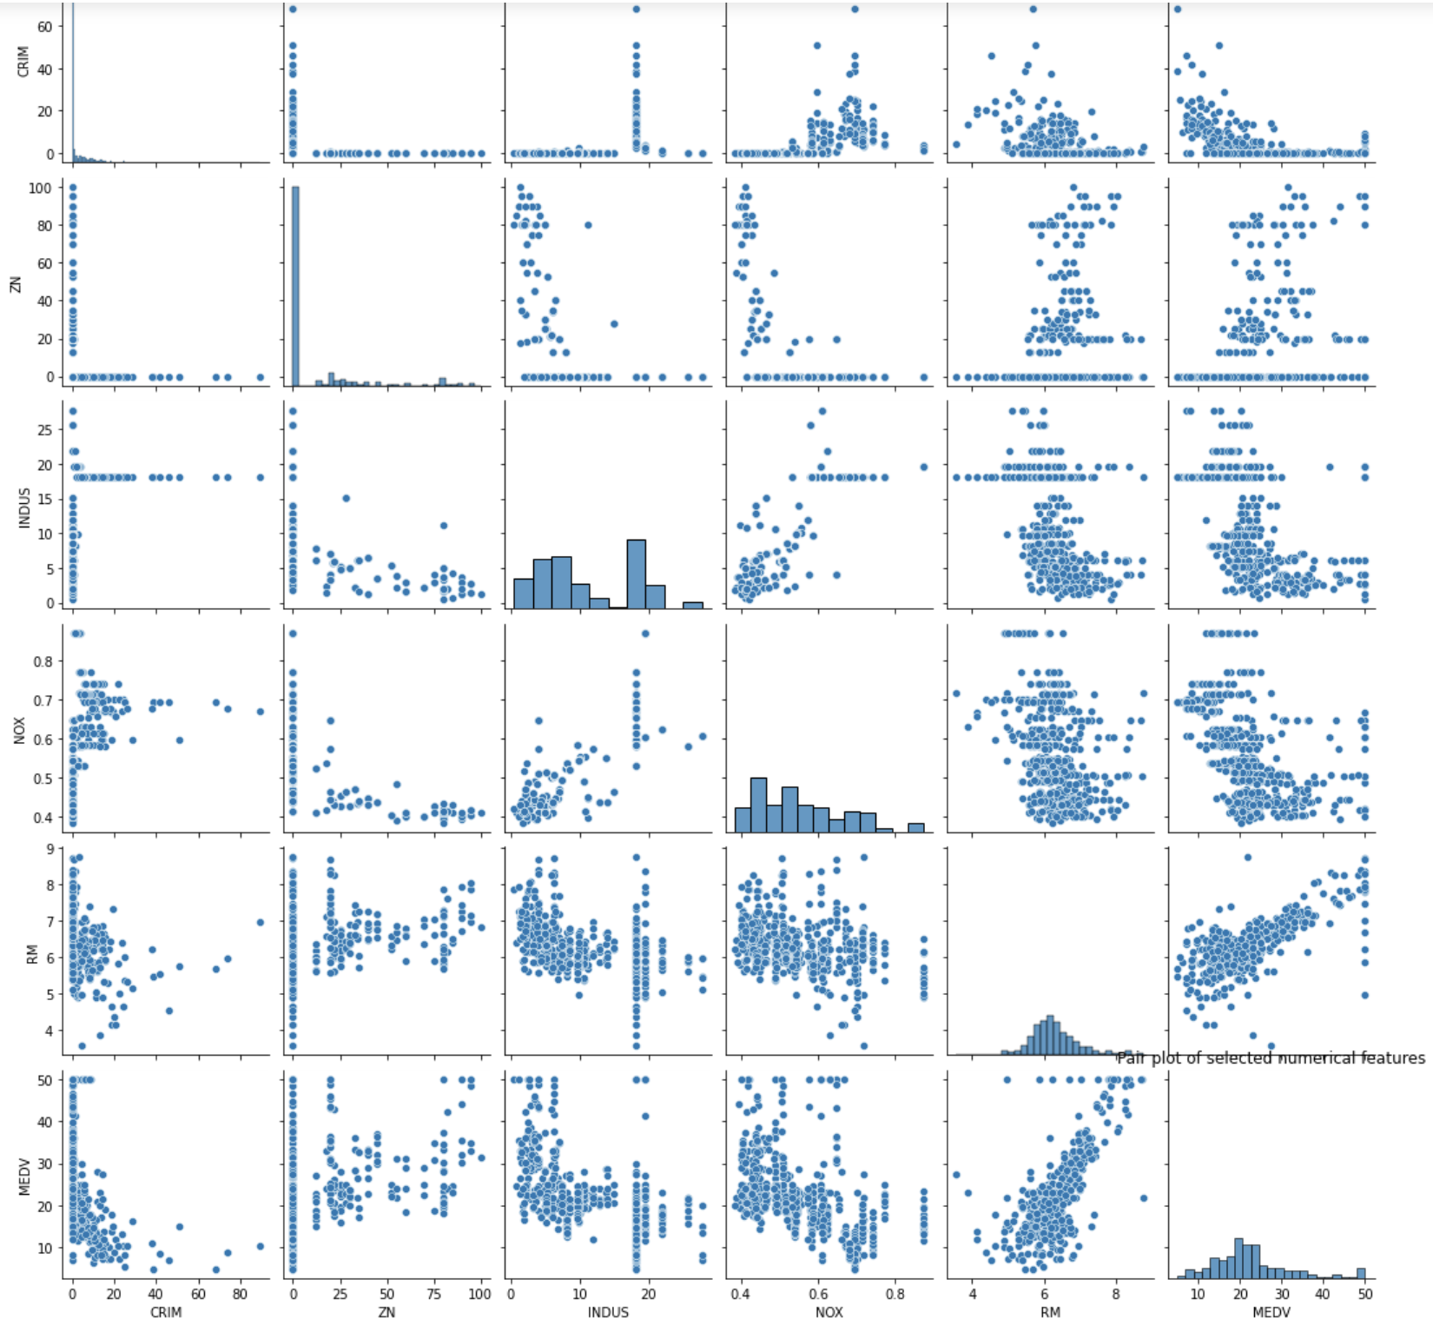
Pair plot for numerical variables like 'CRIM', 'ZN', 'INDUS', 'NOX', 'RM', 'MEDV'.

Slide 10
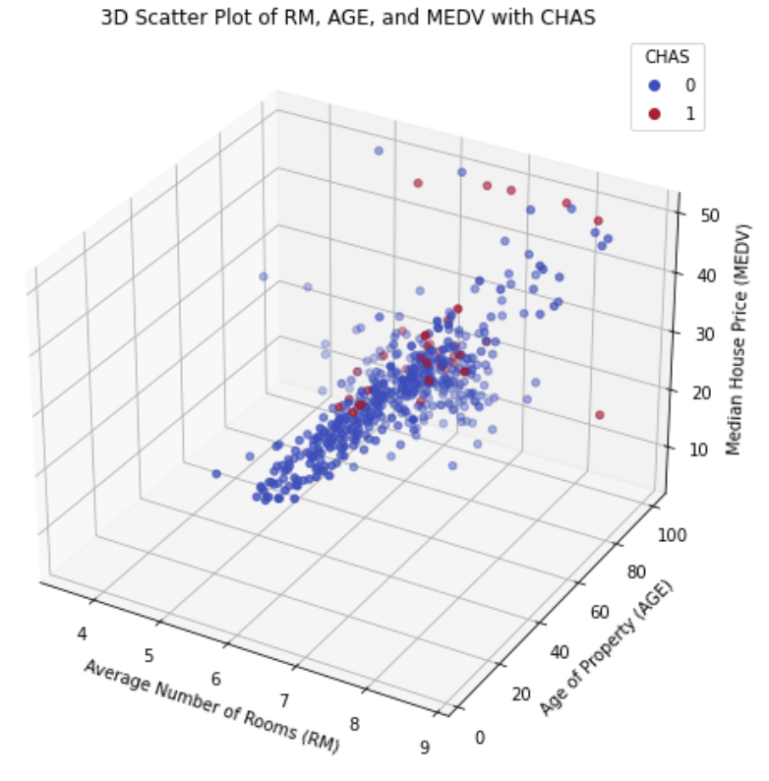
Multivariate Analysis 3D Scatter plot of 'RM, 'AGE' and 'MEDV' with 'CHAS'.

Slide 11
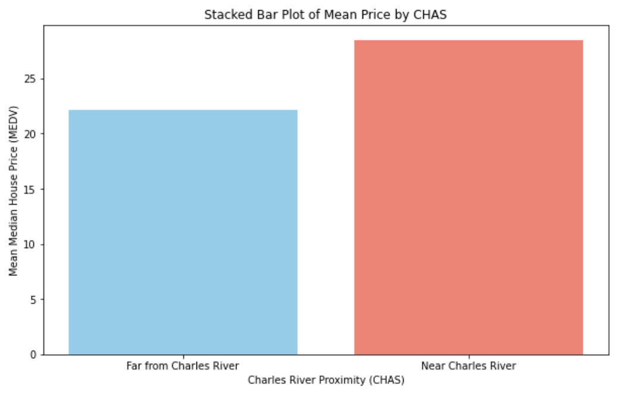
Stacked bar plot of 'MEDV'' by 'CHAS'.

Slide 12
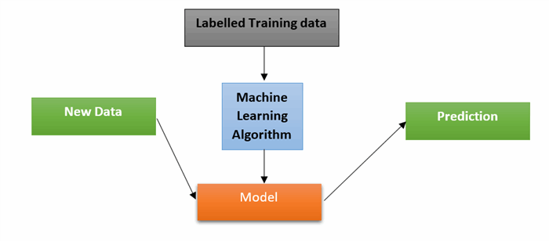
MACHINE LEARNING

Slide 13
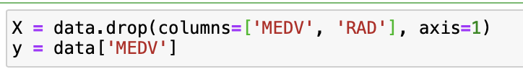
Feature Selection
The variable X contains features from the dataset excluding the columns 'MEDV' (target variable) and 'RAD', representing potential predictors for the target. Meanwhile, the variable y stores the target variable 'MEDV', which is the median value of owner-occupied homes in $1000s.

Slide 14
Model Selection
It outlines the range of models employed for predicting the target variable and highlights the diversity of techniques explored, from traditional linear regression to ensemble methods like decision trees, random forests, and gradient boosting.
Linear Regression
Decision Tree Regression
Random Forest Regression
Extra Trees Regression
Gradient Boosting Regression

Slide 15

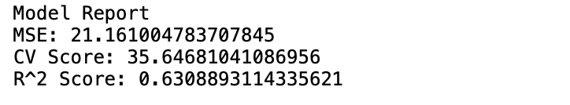
Linear Regression
Linear regression is a statistical technique to model the relationship between two variables by fitting a straight line to the data points.
Performance Evaluation: Mean Squared Error (MSE), R-squared
Cross-Validation:
Cross-validation is a resampling technique used to evaluate the model’s performance on unseen data.

Slide 16
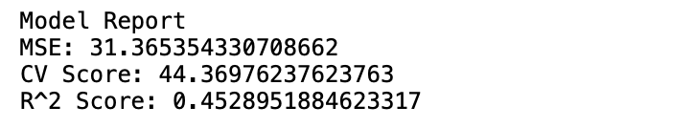
Decision Tree Regression
Normalization of Features:
The features are normalized using StandardScaler.
Model Creation:
Here a Decision Tree Regressor is instantiated with DecisionTreeRegressor(random_state=42). This creates a decision tree model with a fixed random state for reproducibility.
Model Training:
The train function is called to train the Decision Tree Regressor model on the standardized features (X_scaled) and target variable (y).

Slide 17
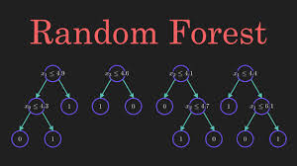
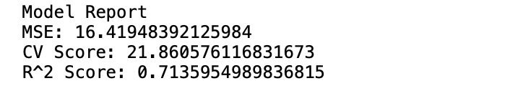
Random Forest Regression
Random Forest Regression employs an ensemble of decision trees to make predictions, providing robustness and flexibility in capturing complex relationships within the data. Its performance is often characterized by low mean squared error, high cross-validation scores, and a strong R-squared score.

Slide 18

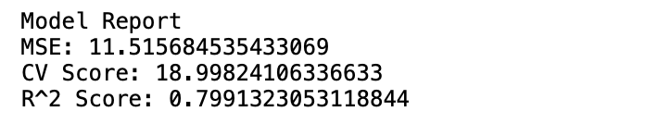
Extra Trees Regression
Extra Trees Regression, an ensemble learning method, constructs a multitude of decision trees and averages their predictions for robust performance. It excels in capturing complex patterns within data, evidenced by low MSE, high CV scores, and a strong R-squared value.

Slide 19
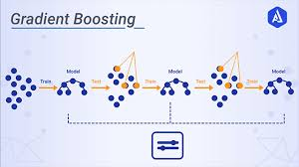
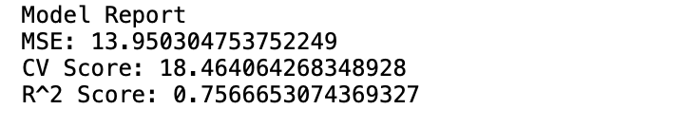
Gradient Boosting Regression
Gradient Boosting Regressor, a powerful ensemble learning technique, iteratively improves upon weak learners (typically decision trees) to optimize predictive performance. It sequentially fits new models to the residual errors of the previous models, resulting in a highly accurate predictive model.

Slide 20
Model Comparison
MODEL | Mean Squared Error (MSE) | Cross-Validation (CV) Score | R-squared Score
Linear Regression | 21.161004783707845 | 35.64681041086956 | 0.6308893114335621
Decision Tree | 31.365354330708662 | 44.36976237623763 | 0.4528951884623317
Random Forest | 16.41948392125984 | 21.860576116831673 | 0.7135954989836815
Extra Trees | 11.515684535433069 | 18.99824106336633 | 0.7991323053118844
Gradient Boosting | 13.950304753752249 | 18.464064268348928 | 0.7566653074369327

Slide 21
Comparison
Extra Trees Regression achieved the lowest Mean Squared Error (MSE) and Cross-Validation (CV) Score, indicating superior performance in prediction accuracy and generalization followed by gradient boosting, Decision tree, Random Forest, linear regression models.
Generally, ensemble methods (Random Forest, Extra Trees, Gradient Boosting) outperformed traditional linear regression and decision tree models, highlighting the importance of leveraging ensemble techniques for improved predictive performance.

Slide 22
WEB APPLICATION
Our web application aims to provide an intuitive interface for users to predict median house prices in Boston based on various features. Leveraging the Streamlit framework, we developed an interactive app that allows users to input feature values such as crime rate, proportion of residential land, and more. The application utilizes a trained machine learning model, specifically an ExtraTreesRegressor, to make predictions. Additionally, we enhanced the visual appeal of the app by incorporating a background image related to the theme of house price prediction. By deploying the application, we've made it accessible to users, enabling them to obtain accurate predictions and gain insights into the Boston housing market.
The term "median value of owner-occupied homes in $1000s" refers to the median price of homes that are occupied by their owners, measured in thousands of dollars.

Slide 23

If Charles river=1(near to river)

Slide 24

If Charles River=0(Away from river)

Slide 25
Conclusion
The project revealed that ensemble methods such as Random Forest, Extra Trees, and Gradient Boosting consistently outperformed traditional linear regression and decision tree models in predicting housing prices. Additionally, feature engineering, model selection, and hyperparameter tuning played crucial roles in optimizing model performance, underscoring the significance of a comprehensive approach to regression analysis.

Slide 26
Future Scope
For future work, incorporating more advanced feature engineering techniques, exploring different ensemble methods, and conducting thorough sensitivity analysis on hyperparameters could further enhance predictive accuracy. Additionally, integrating domain knowledge and exploring alternative data sources may offer valuable insights for improving model robustness and interpretability in real-world applications.

Slide 27


